Slide 1

Virtual Global
Open House
Overview of the Program

Slide 2

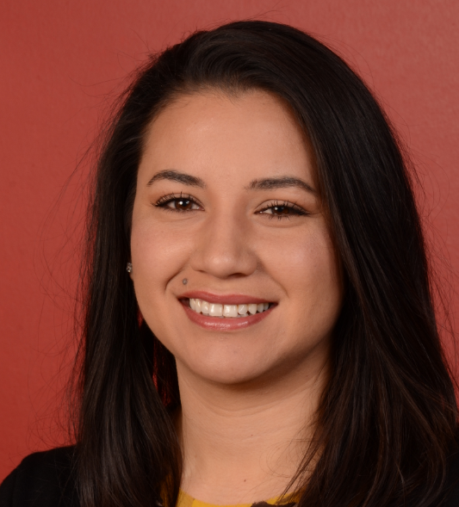
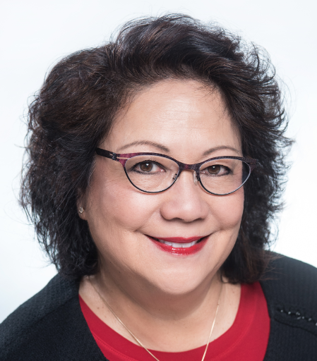

Overview of the Virtual Global Open House
photo
Valerie Renz
Fran Furtner
Today’s presentation will cover:
Objectives of the Virtual Global Open House
Chorus and regional participation
Additional Zoom meetings for more information
Getting started

Slide 3

Over the Past 6 Months
It’s been challenging!
We’ve learned and adapted to virtual rehearsals.
We’ve been focused on member engagement, satisfaction and retention – as we should be.
Despite best efforts, our membership has dropped overall – and for the first time in a long time, our membership is below 20,000.
Let’s rally and work together to turn this trend around.
March
2020

Slide 4


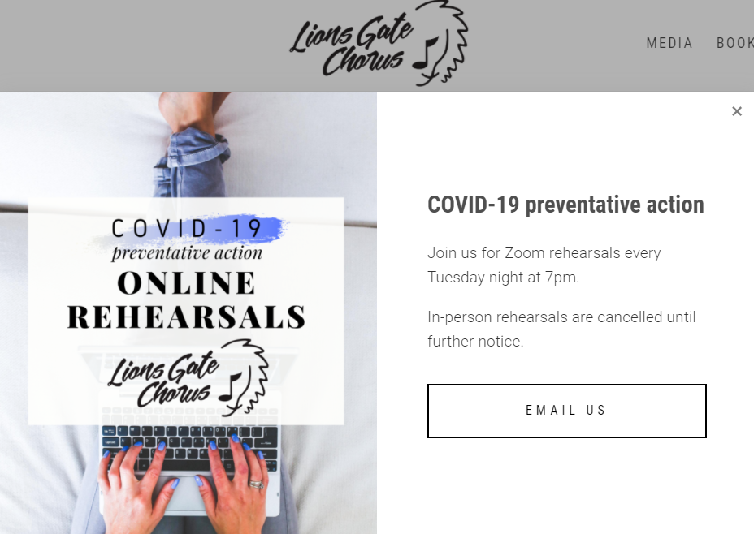
Member Recruitment
Some choruses have added a few members
A number of choruses have an open invitation on their websites
Many choruses have had the occasional guest
But significant and proactive recruitment hasn’t been a priority
Now is the time to focus on attracting new members again
photo

Slide 5
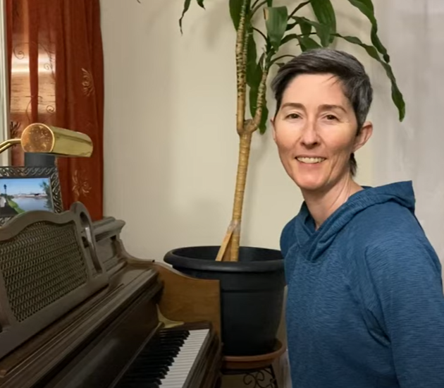
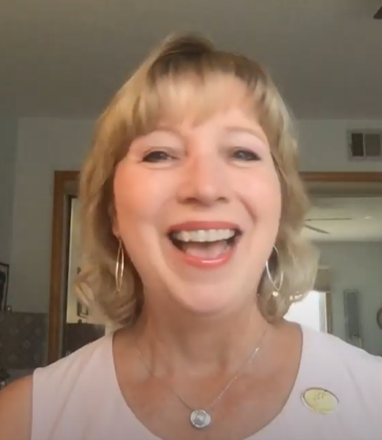
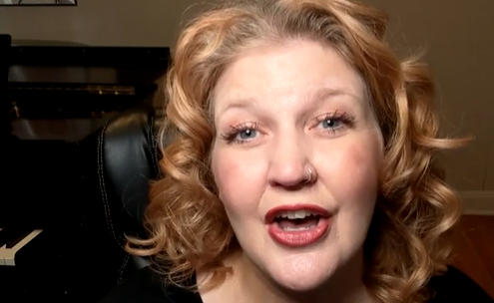
We Have a Lot to Offer
Education and skill development
Fellowship and fun
Virtual rehearsals have opened new doors
We can watch ourselves sing
We can access rehearsal from anywhere
We have a vast and rich array of teachers, friends, and resources outside our usual circle
We have a stronger sense of connection and community as we journey through this phase together
Singers WANT what we have to offer
photo

Slide 6

A Rare Opportunity
The 75th Anniversary Virtual Convention on Oct. 15-17 can help prospective members understand
the breadth and depth of our organization – knowledge, talent, accomplishments, friendships
our history and our vision for the future
https://sweetadelines.com/2020-Virtual-Convention
FREE
State of the organization
Education classes
Special awards
Most memorable performances in SA history
Check-ins with champions and regions
Opportunities to sing

Slide 7
A Rare Opportunity
The Coronet Club’s “First You Dream” Show
A free, live stream event on October 24
Best-in-class entertainment and another view into our world
photo

Slide 8
To Summarize . . .
Next Steps
photo
Let’s start building our membership again
Singers are looking for the many benefits we have to offer
We have an extraordinary opportunity to show prospective members multiple facets of our organization in a short window of time
Let’s open our virtual doors and arms to guests – and show them the talent, joy, and love that is Sweet Adelines International
Important Need
Lots to Offer
Rare Opportunity

Slide 9
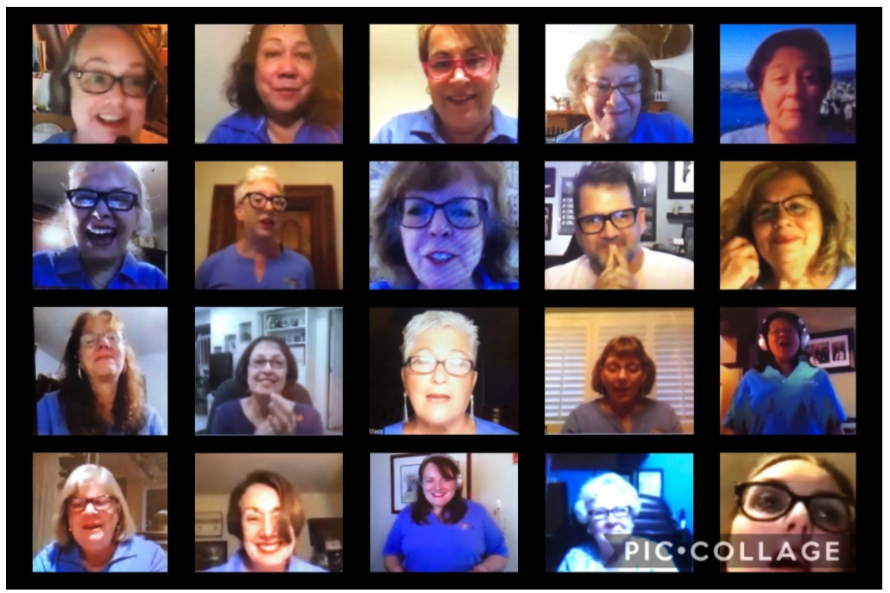
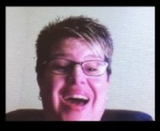
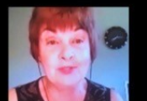
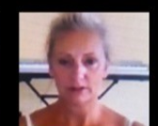
Virtual Global Open House in October
A worldwide, coordinated and concerted effort to bring in new members
photo
We acknowledge that’s fast timing – and we want to make it as easy as possible on you
Choruses
Dedicate one of your rehearsals in October to a virtual guest night
Actively market to new prospects and former members
Make it easy for guests to join you and enjoy their time with you
Invite guests to participate in regional and international events
Stay connected; follow up

Slide 10

Virtual Global Open House in October
A worldwide, coordinated and concerted effort to bring in new members
Regions
Guide and support your chapters in their virtual guest nights
Track participation, offer incentives, showcase innovative ideas
If you already have a regional event or afterglow planned, consider adding something special for guests
If you don’t, consider holding an afterglow around the International Virtual Convention to acknowledge and celebrate those who would’ve been competing or getting awards in Louisville – and showing guests what it means to be part of a region
Open your regional doors to guests from any area
photo

Slide 11
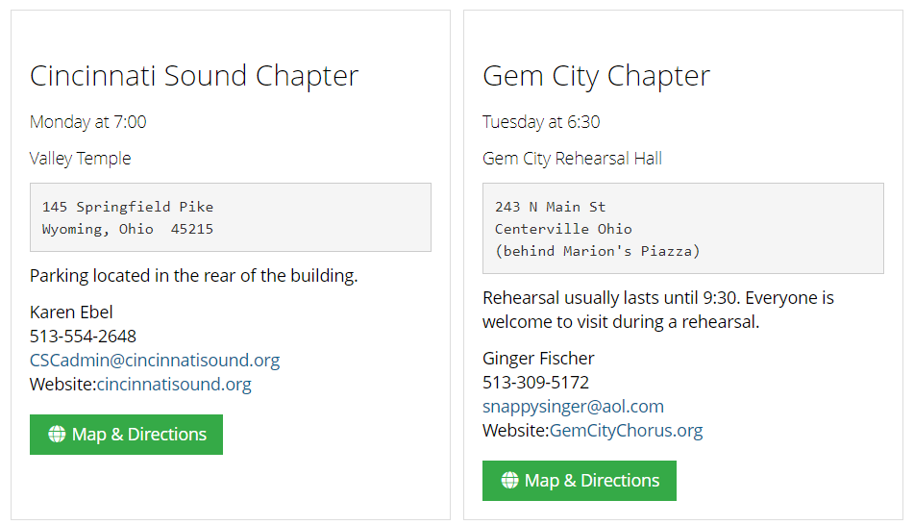
International will promote the VGOH in social media and on the SAI website
Ensure your chorus website is in your profile so it will appear in any searches from the Find A Chorus button
Contact member@sweetadelines.com to update your profile

Slide 12
Zoom Meetings to Provide More Information
All live sessions will be recorded and accessible on . . .
photo
Thursday, September 10, 2020
12 noon CDT* Marketing Tools & Templates on the Sweet Adelines International Website | 2 pm CDT Regional Roles & How to Host a Regional Afterglow or Event
Social Media Promotional Videos Digital Ads Post Cards Public Relations Plan Virtual Rehearsal Resources Teaser for How to Market for New Members in a Virtual Environment | Regional leadership roles in guiding and supporting your chapters Technical resources; buddy system Showcasing creative Guest Night ideas Building momentum Hosting a great regional afterglow or event Welcoming guests to your regional event
*CDT = U.S. Central Daylight Time (Tulsa Time)

Slide 13
Zoom Meetings
Friday, September 11, 2020
12 noon CDT 7 Tips on How to Promote Your Virtual Open House | 2 pm CDT Planning a Successful Virtual Rehearsal for Guests
Chorus vision Planning Innovative content Facebook Other social media Activating Your members Following up | Planning; making a fabulous first impression Advance sign-ups Greetings; breakout room with Director, Membership Chair and guests Singing together; sheet music and tracks Sharing a chorus performance Explaining the breadth of SAI; invitations to regional and international activities Staying connected
photo

Slide 14

Next Steps
photo
Start planning and preparing your chorus and region
Actively market your event; word-of-mouth and social media are most effective
Send us examples of your marketing materials and share your successes and stories. We want to hear from you!
Stay tuned for additional Zoom meetings at the end of September that will share ideas on how to stay connected with guests and hopefully, turn them into members – including programs or projects and possible incentives to join before year-end.
Let’s start growing again – and plant the seeds for our next 75 years!

Slide 15

Thank You!
Your Membership Department *
Valerie Renz – valerie@sweetadelines.com
Keisha Gansen – keisha@sweetadeines.com
Chorus Growth Incentive Task Force
Fran Furtner
Bridget Barrett
Jen Cooke
Deb Ferenc
Heli Hemgård
Jen Zucker
* For questions or more information, please contact the Membership Department

