Slide 1

Virtual Global
Open House
Planning a Successful
Virtual Rehearsal for Guests

Slide 2

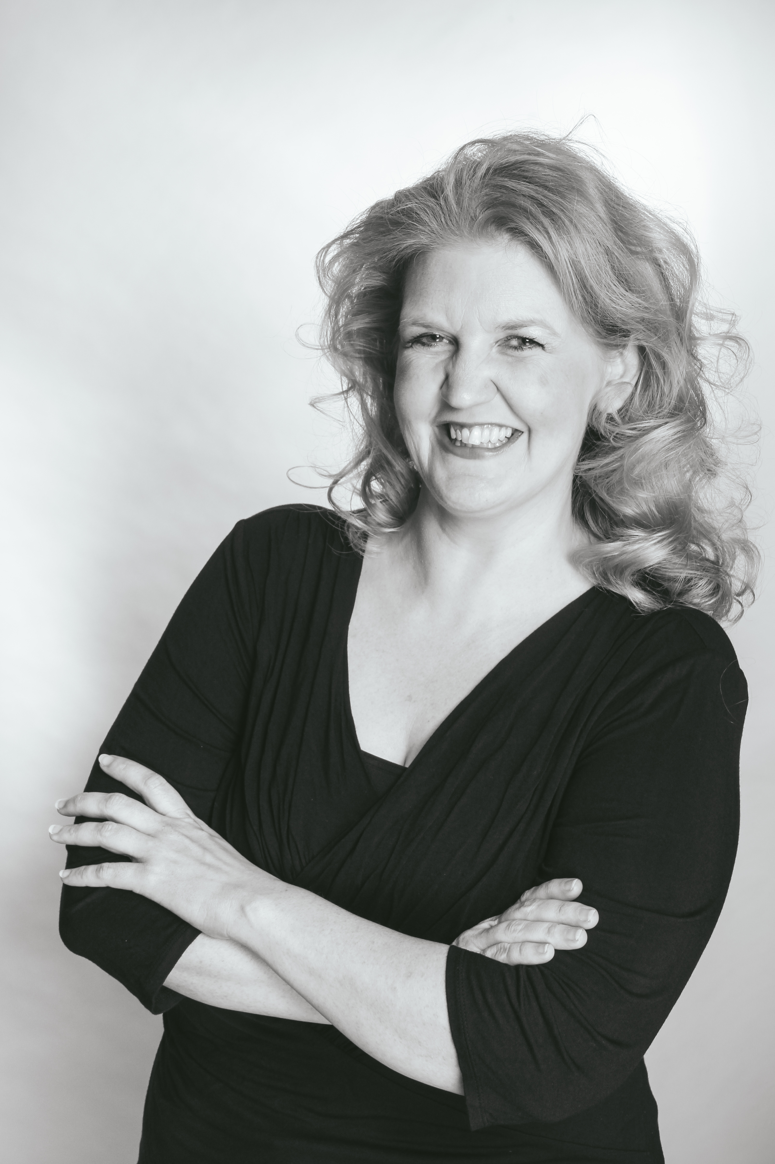
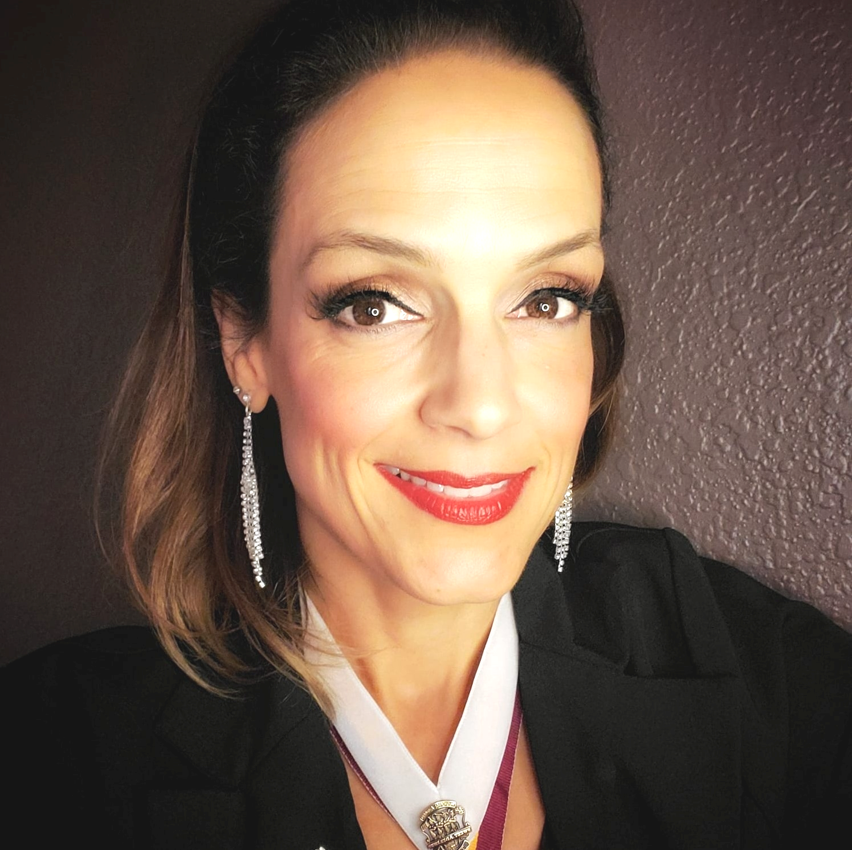

Overview of the Virtual Global Open House
Bridget
Barrett
Jennifer
Cooke
Today’s presentation will cover:
Planning
First Impressions
Voice Placement
Riser Buddies
Follow Up

Slide 3
Planning
photo
Planning for a virtual guest night can simultaneously be simpler and more time-consuming than planning for an in-person event. To prepare, make sure you have a team that can communicate well (especially digitally), is tech-savvy, and knows the ins and outs of the chorus audition process.
Plan a rehearsal that demonstrates a "normal" rehearsal night, along with some special, fun activities that will introduce potential members to the art of barbershop.
Publicity should be wide-spread, utilize social media, and have buy-in from all chorus members. After publicizing and planning a virtual guest night, get ready for an evening of connection and excitement!

Slide 4
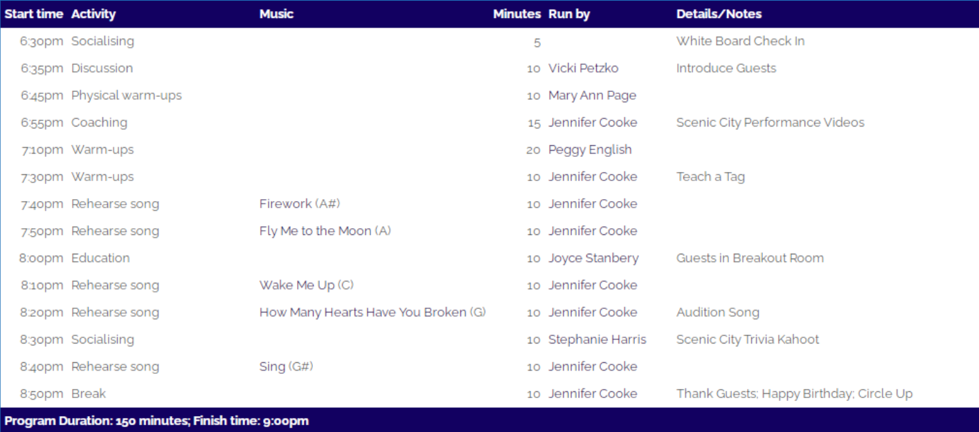
Planning
Sample Guest Night Schedule
photo

Slide 5
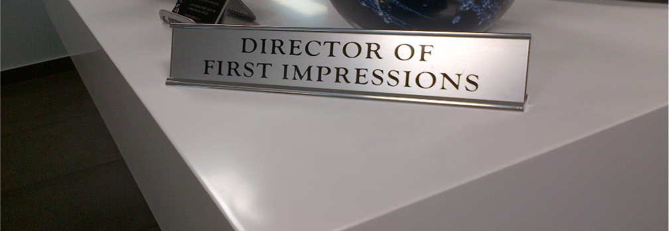
First Impressions . . .
photo
When a new member walks through the door, they should experience the following:
A cheerful greeting from the designated membership team person. The rest of the members should feel free to greet the potential member, as well, without overwhelming them.
Face-to-face conversation with the director, whether it be through voice placement or a simple chat to make the potential member feel they have a connection with leadership.
Rudimentary voice placement, and a recommended voice part for the evening.
A knowledgeable, positive riser buddy who sings the same part and is helpful and personable.
Time to ask questions, give feedback, and learn more about how to become a member.
Follow up at the end of the rehearsal by a member of the Membership team and the director.

Slide 6


First Impressions . . . Virtually
photo
On Zoom, the new guest should be greeted by name and welcomed. The membership team lead and director should be spotlighted for recognition.
Face-to-face conversation with the director, through a breakout room. Voice placement should also happen during this time, with music leadership taking over rehearsal until the director and new member return (messages can be sent to the breakout room as needed).
Guest can connect with a riser buddy through private chat, where they can ask questions, and the riser buddy can check on the guest periodically.
During education or business, create a breakout room for the guest(s) and member team.
Director personally acknowledges the guests, by name, at the end of rehearsal.

Slide 7

The Greeting . . .
photo
Does everyone in the chorus know where to direct a new member? Designated greeters should always be present and known.
The greeter should welcome the potential new member, ask their name, and find out how they learned about the chorus.
There should be a sign-in sheet for all visitors that includes contact information.
The greeter then introduces the potential new member to the director and the person who will be voice placing (if applicable)
The greeter waits until voice placement is over and then assists the visitor by learning who the riser buddy is, procuring a guest book, and escorting them to the risers.

Slide 8

The Greeting . . . Virtually
If a member notices a new guest, they should chat privately with the director and membership team lead to make sure they know.
If there is a designated greeter, they can use the chat to welcome the member and ask any pertinent questions.
A sign-in sheet can be created with Google forms, sharing the link in the chat for new guests.
For new guests, voice placement can be done in a separate breakout room during warmups or social time.
There should be a built-in time during rehearsals for the membership team or greeter to introduce guests.
Sheet music can be shared via screen share or other designated method.

Slide 9

Voice Placement . . .
Conducted by a music team member or the director.
Simple voice exercise or well-known song.
Include conversation in which the guest can outline their vocal background.
Short explanation of the barbershop art form.
Positive and realistic feedback.
Results in suggested voice part during the rehearsal, along with a riser buddy assignment
photo

Slide 10
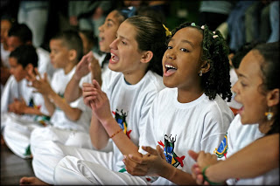
Voice Placement . . . Virtually
photo
Breakout room with MT member or director.
Need strong leadership to conduct rehearsal if director is voice placing.
Screen share can be used to explain barbershop art form, how to read the music, etc.
When returning to rehearsal, the director can use the chat to privately contact membership team member, riser buddy, and new guest.
Alternately, a breakout room could be used to introduce the guest to their riser buddy and explain how they can ask questions and get information during a rehearsal.
There should be an established procedure for providing/sharing sheet music with guests during rehearsal time.

Slide 11

Riser Buddies . . .
photo
Riser Buddies should be . . .
Pre-determined for each voice part and trained on a regular basis
Relatively strong, accurate singers with musical/barbershop knowledge
Knowledgeable about the schedule for a new member for each rehearsal
Energetic and positive, but not overwhelming
Able to contact the director with potential problems or questions during rehearsal -- the guest's "voice" during rehearsal time

Slide 12

Riser Buddies . . . Virtually
photo
Rehearsal buddy should meet with guest either through private chat or breakout room prior to the guest joining rehearsal
The riser buddy should "check in," via chat, with their guest several times during the course of rehearsal
Director should be more aware of the guests, as well, since the riser buddies can't guide their singing. This may include playing more part-alone tracks, more explanation of terms, etc.
The director should also be in contact with buddies on private chat, when necessary.

Slide 13

Follow Up . . .
photo
Plan for them to come back! Give the potential members all the materials they need to return the following week:
Website Info
Audition Materials
Contact information for the Membership Liaison and the Director
Follow-up email or phone call
First/second visit packets (as applicable)
If the chorus goes out after rehearsal, invite the guest to come along.

Slide 14

Follow Up . . . Virtually
Make sure all guest materials are available in digital format, so that they can be emailed to guests.
On the sign-in sheet, determine the best mode of communication for each guest and use it.
Make sure the digital audition process is well-thought-out and clearly communicated to each guest.
Invite the guest to any online social events that may be scheduled outside of regular rehearsal time.
photo

Slide 15

For Discussion . . .
What is your current new member protocol?
How can you adapt that protocol to create a positive virtual experience for the potential new member?
What issues/advantages are unique to your chorus, and how can you use these to make the new member experience memorable?
What are your concrete “next steps” to refine the potential new member experience in your chapter?
photo

Slide 16

photo

Slide 17

Thank You!
Your Membership Department *
Valerie Renz – valerie@sweetadelines.com
Keisha Gansen – keisha@sweetadelines.com
Laura Crockett – laura@sweetadelines.com
Chorus Growth Incentive Task Force
Fran Furtner
Bridget Barrett
Jen Cooke
Deb Ferenc
Heli Hemgård
Jen Zucker
* For questions or more information, please contact the Membership Department

